Slide 1
Ice Cream Manufacturing Industry Software
InfoCentroid Software Solution Pvt. Ltd.
www.infocentroid.com
Contact Numbers:+91-7566663042,07314047162

Slide 2
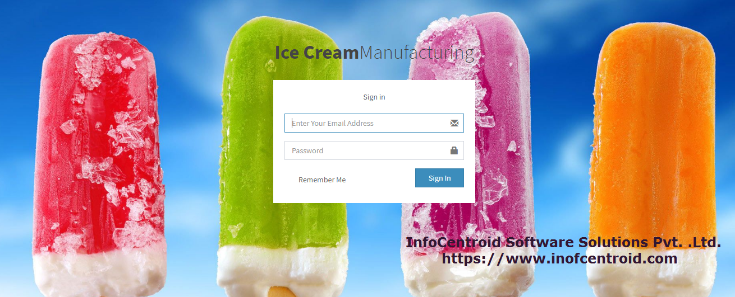
Ice Cream Manufacturer Increase Your Productivity With InfoCentroid
InfoCentroid Software Solution Pvt. Ltd.
www.infocentroid.com
Contact Numbers:+91-7566663042,07314047162

Slide 3
InfoCentroid has developed software which manage your end to end operations. That start from when you enter icecream in to the cold storage, create sale order for dispatching, release vehicle for the delivery, create invoice, collect payment, manage tax , manage cancel order and manage accounting .
It’s one shot solutions of your Stock, Inventory, Sales Order, Invoicing, GST Auditing and Accounting.
InfoCentroid Software Solution Pvt. Ltd.
www.infocentroid.com
Contact Numbers:+91-7566663042,07314047162

Slide 4
Features
Master Data Entry :You can enter master data which consistent and uniform set of identifiers that describes the core entity of enterprises like Ice Cream Type, Ice Cream Category, Ice Cream Sub Category , State, Quantity, Flavors, HST&GST, Batch No.
InfoCentroid Software Solution Pvt. Ltd.
www.infocentroid.com
Contact Numbers:+91-7566663042,07314047162

Slide 5
Customer Module: You can add customer with all relevant parameters and can view the list of all customers , Can edit and delete as well
InfoCentroid Software Solution Pvt. Ltd.
www.infocentroid.com
Contact Numbers:+91-7566663042,07314047162

Slide 6
Cold Storage Module: You can add cold storage will all relevant parameters and can view the list of all cold storages, Can edit and close it as well
InfoCentroid Software Solution Pvt. Ltd.
www.infocentroid.com
Contact Numbers:+91-7566663042,07314047162

Slide 7
Stock & Inventory Module: You can add the stock in the cold storage with all relevant parameters like ice cream type, flavor , catagoriy , quanity, unit etc. and can watch inventory . You can edit and delete it as well
Stock deduction will be held once invoice will be created , If invoice cancelled then stock quantities will be roll backed
InfoCentroid Software Solution Pvt. Ltd.
www.infocentroid.com
Contact Numbers:+91-7566663042,07314047162

Slide 8
Sales Module: You can create sales request , can give print out of it your staff , for preparing the sales order .Here is option to cancel sales request as well . Sales requests list you can watch, can edit and delete as well
InfoCentroid Software Solution Pvt. Ltd.
www.infocentroid.com
Contact Numbers:+91-7566663042,07314047162

Slide 9
Invoicing Module: You can create invoice, invoice will be customized according to your need . You can take n- number of print outs of it . List of invoices are also there you can cancel the invoice as well. Once invoice created then automatically stock will be deducted from the stock ,But if you cancel the invoice then stock quantities will be rolled back
InfoCentroid Software Solution Pvt. Ltd.
www.infocentroid.com
Contact Numbers:+91-7566663042,07314047162

Slide 10
Expense Module : It cover all expense details related to ledgers, either is regular expense voucher or from vendor purchase
GST Module: This module generate gst audit sheet , you can export it as .csv file
Accounting Module: This module deals with your all accounting and its reports .
InfoCentroid Software Solution Pvt. Ltd.
www.infocentroid.com
Contact Numbers:+91-7566663042,07314047162

Slide 11
Thank You ,
Please feel free to conctact us any time , you can run its demo as well, kindly find its demo link in our web site
www.infocentroid .com
Contact Numbers: +91-7566663042,07314047162

